Slide 1

Master of Science (Data Science & Big Data Analytics)
F. Y. M.Sc. (DS & BDA)
SCHOOL OF ENGINEERING AND TECHNOLOGY
DEPARTMENT OF COMPUTER SCIENCE & APPLICATION
2023-2025

Slide 2
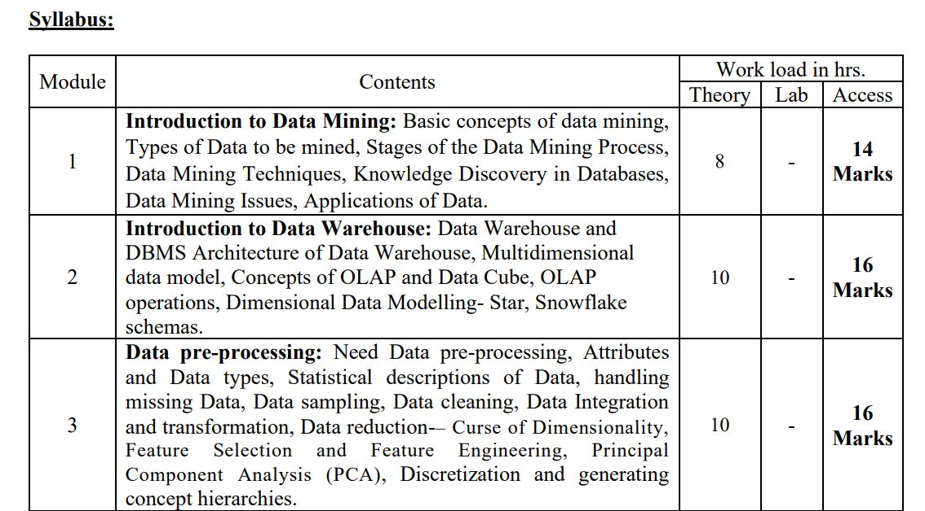
Data Warehousing & Data Mining

Slide 3
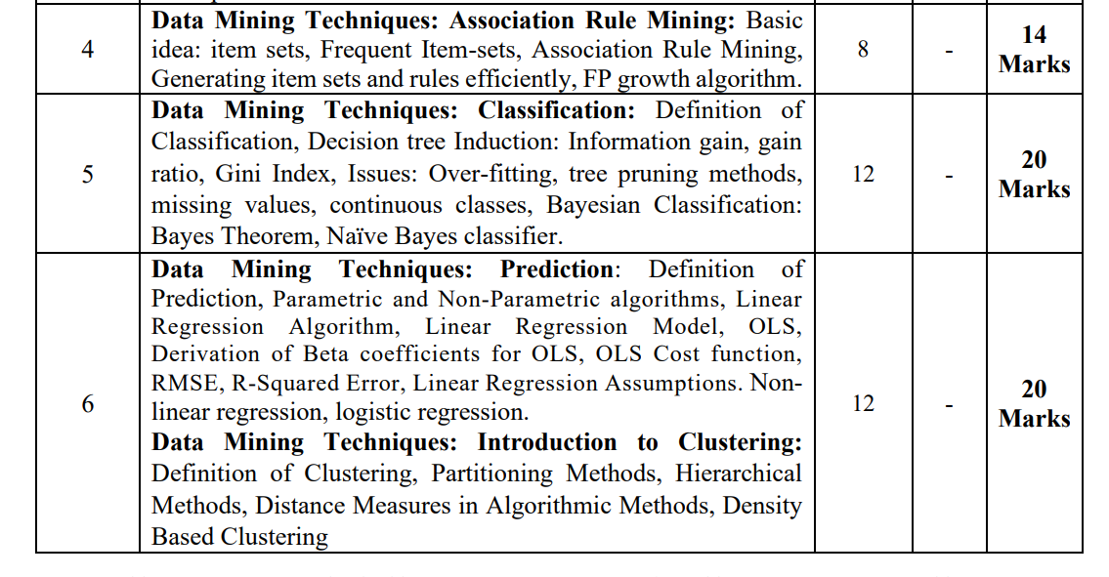

Slide 4
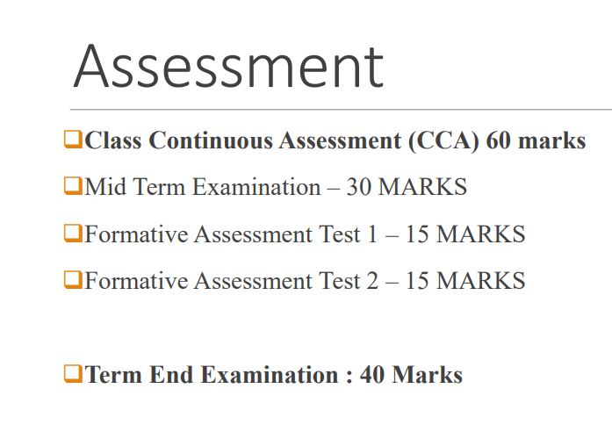

Slide 5
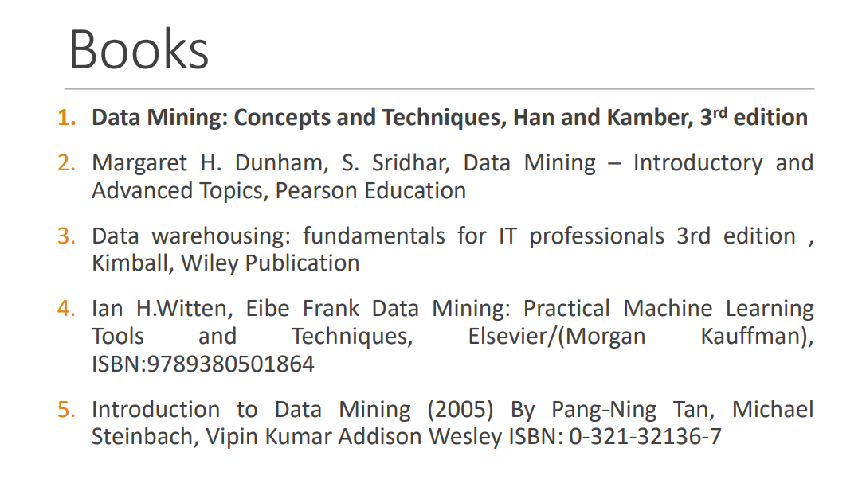
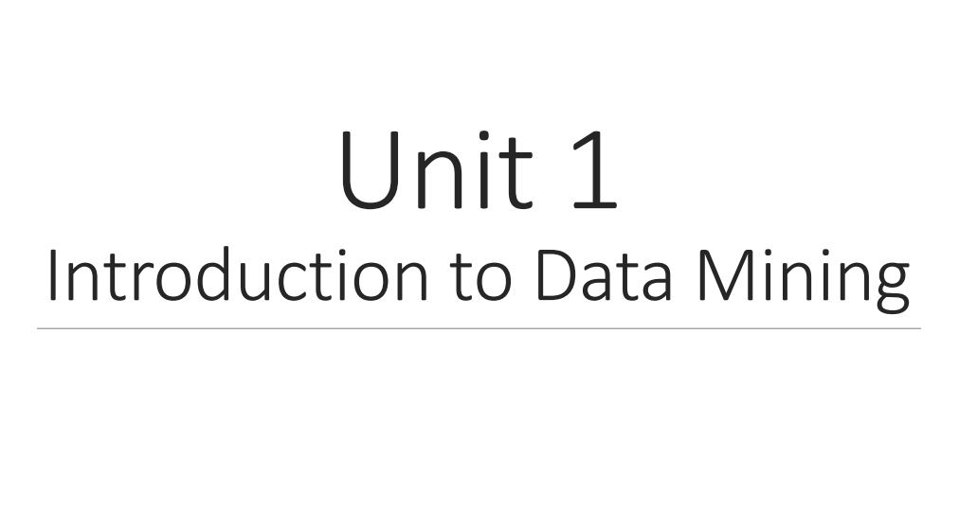

Slide 6
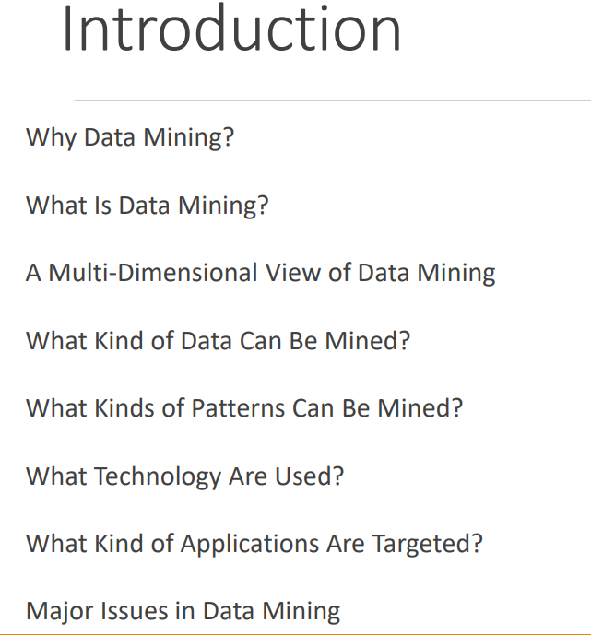

Slide 7
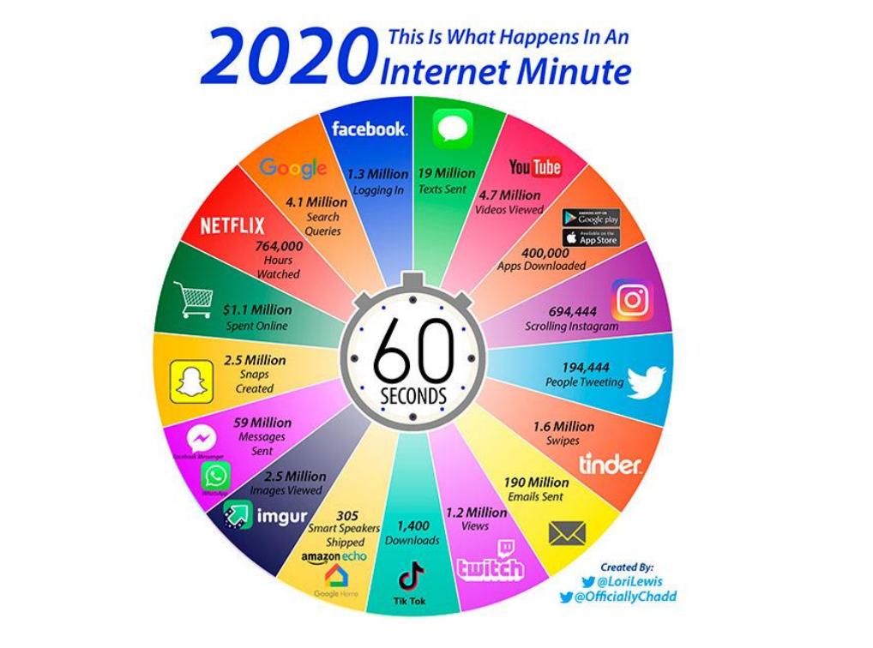

Slide 8
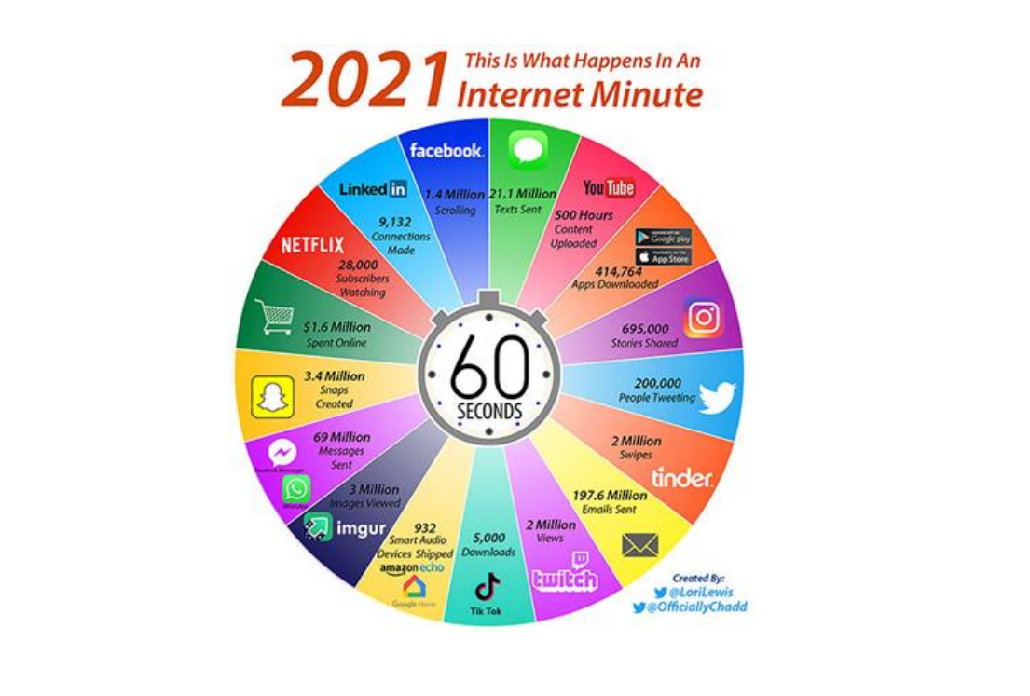

Slide 9
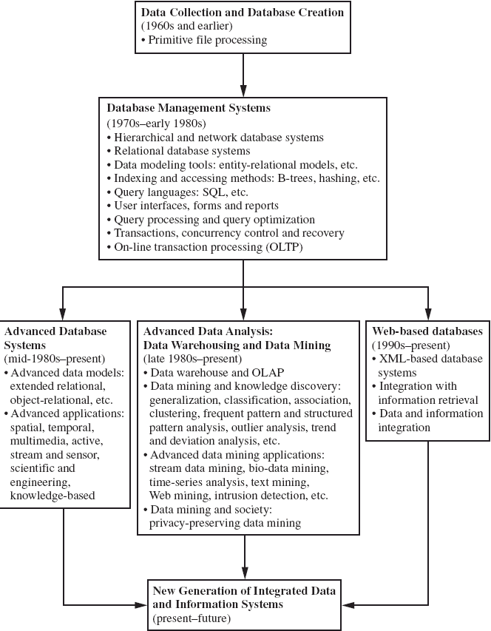
Evolution of Database Technology

Slide 10
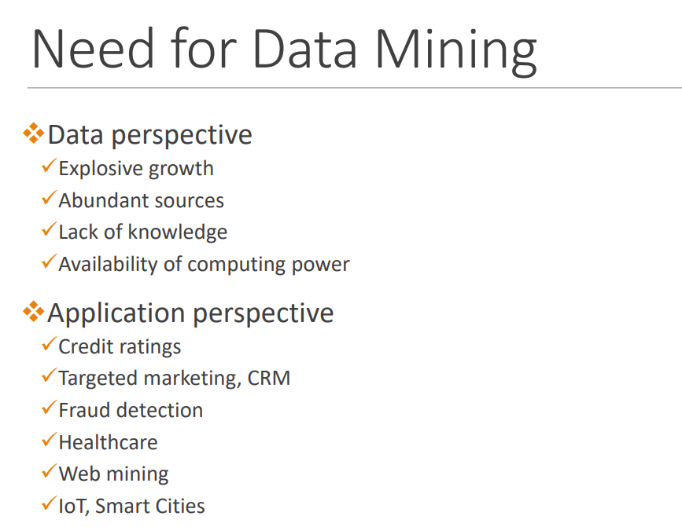

Slide 11
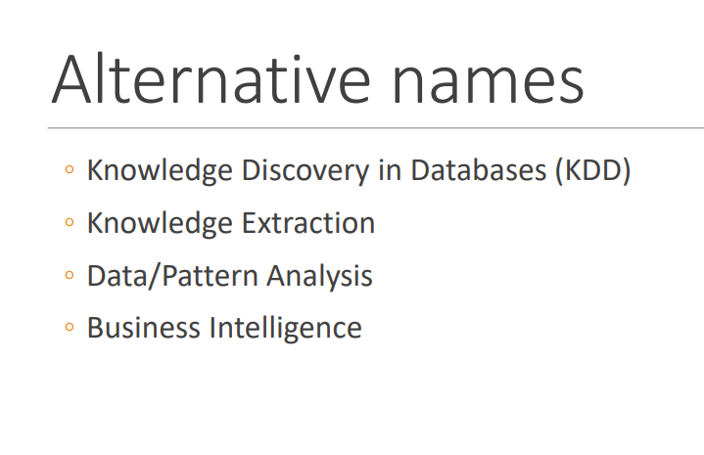

Slide 12
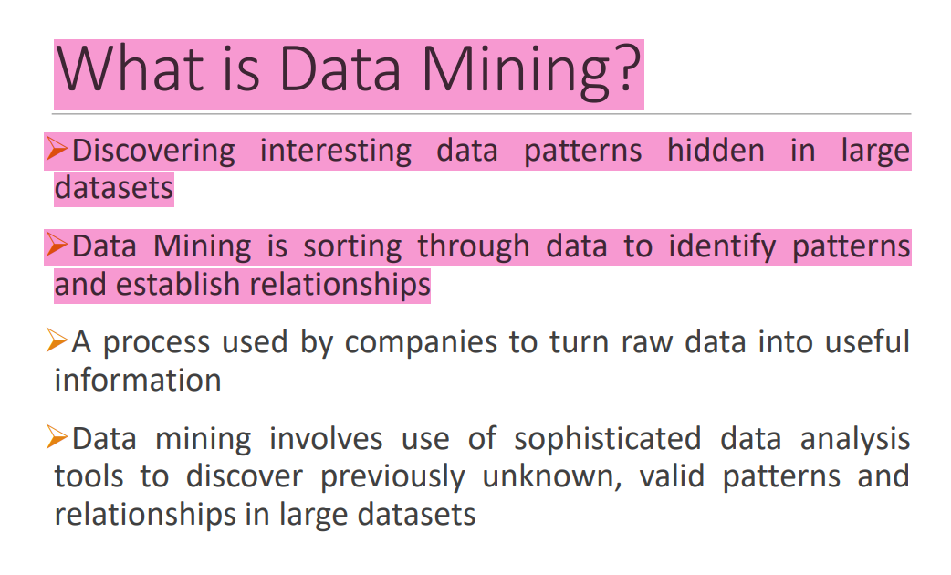

Slide 13
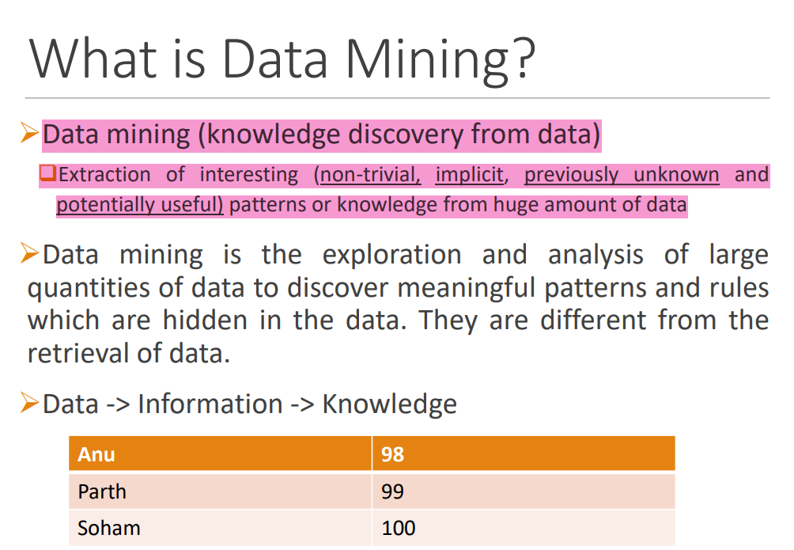

Slide 14
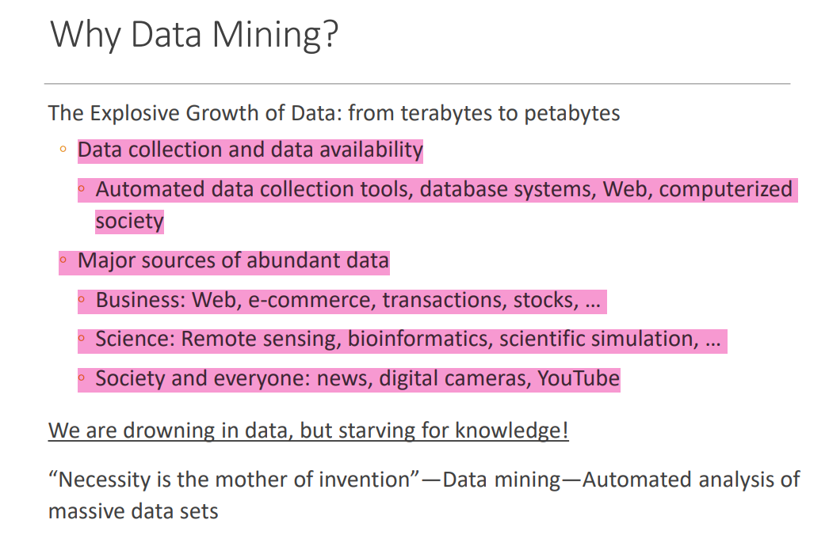

Slide 15
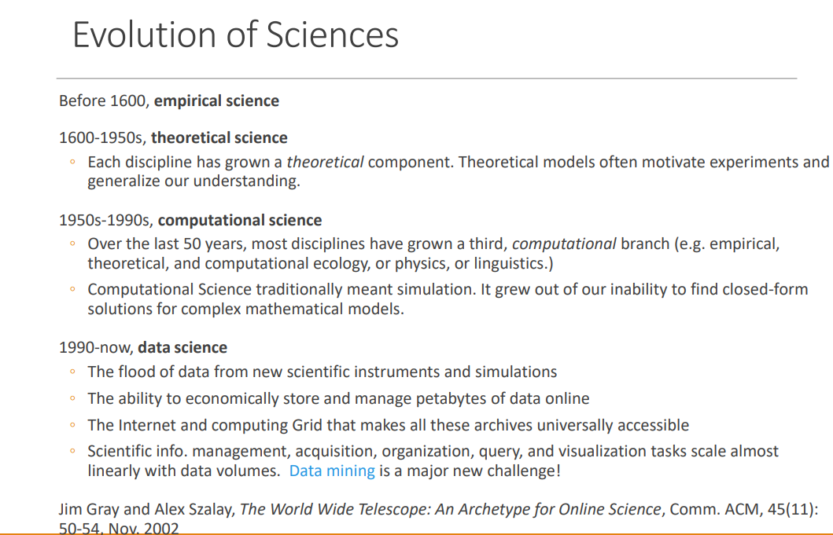

Slide 16
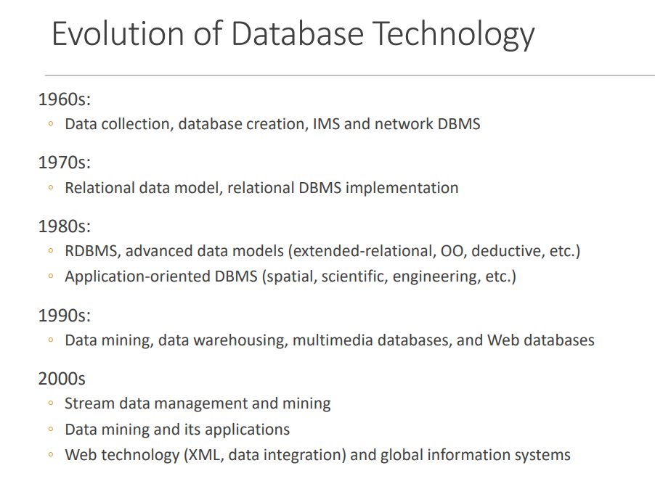

Slide 17
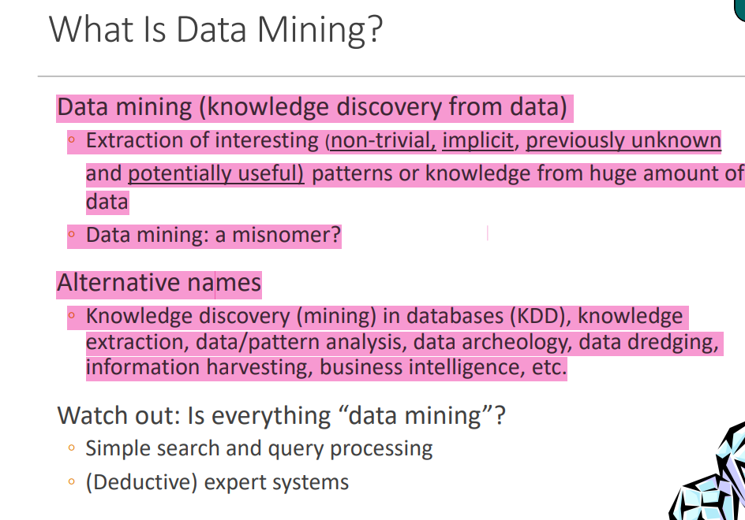

Slide 18
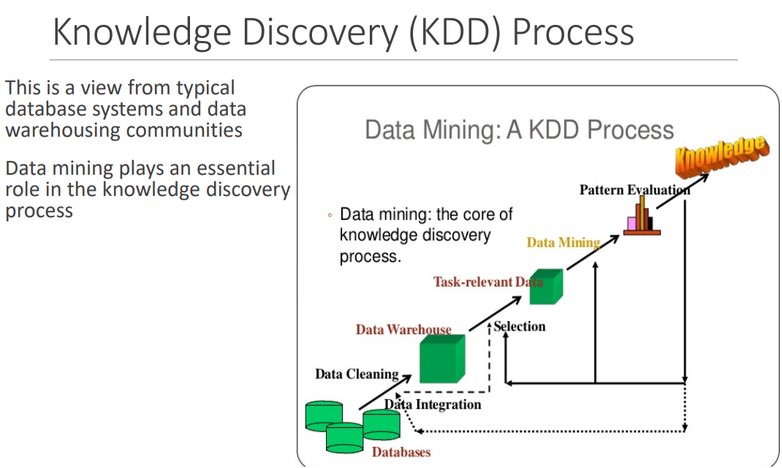

Slide 19
KDD Process: Several Key Steps
Learning the application domain
relevant prior knowledge and goals of application
Identifying a target data set: data selection
Data processing
Data cleaning (remove noise and inconsistent data)
Data integration (multiple data sources maybe combined)
Data selection (data relevant to the analysis task are retrieved from database)
Data transformation (data transformed or consolidated into forms appropriate for mining)
(Done with data preprocessing)
Data mining (an essential process where intelligent methods are applied to extract
data patterns)
Pattern evaluation (indentify the truly interesting patterns)
Knowledge presentation (mined knowledge is presented to the user with
visualization or representation techniques)
Use of discovered knowledge

Slide 20
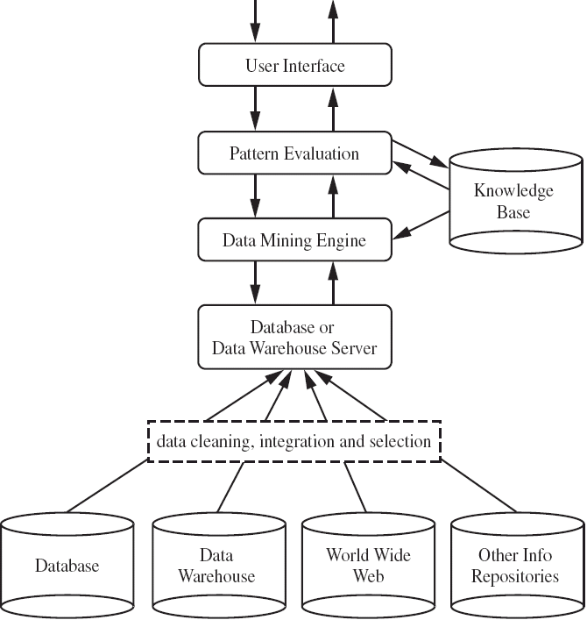
A typical DM System Architecture (2)

Slide 21
Data Mining Functionalities - What kinds of patterns can be mined?
Concept/Class Description: Characterization and Discrimination
Data can be associated with classes or concepts.
E.g. classes of items – computers, printers, …
concepts of customers – bigSpenders, budgetSpenders, …
How to describe these items or concepts?
Descriptions can be derived via
Data characterization – summarizing the general characteristics of a
target class of data.
E.g. summarizing the characteristics of customers who spend more than $1,000 a year
at AllElectronics. Result can be a general profile of the customers, such as 40 – 50 years old, employed, have excellent credit ratings.

Slide 22
Data discrimination – comparing the target class with one or a set of
comparative classes
E.g. Compare the general features of software products whole sales increase by 10% in the last year with those whose sales decrease by 30% during the same period
Or both of the above
Mining Frequent Patterns, Associations and
Correlations
Frequent itemset: a set of items that frequently appear
together in a transactional data set (e.g. milk and bread)
Frequent subsequence: a pattern that customers tend to purchase product A, followed by a purchase of product B

Slide 23
Association Analysis: find frequent patterns
E.g. a sample analysis result – an association rule:
buys(X, “computer”) => buys(X, “software”) [support = 1%, confidence = 50%]
(if a customer buys a computer, there is a 50% chance that she will buy software. 1% of all of the transactions under analysis showed that computer and software
are purchased together. )
Associations rules are discarded as uninteresting if they do not satisfy both a minimum support threshold and a minimum confidence threshold.
Correlation Analysis: additional analysis to find statistical correlations between associated pairs

Slide 24
Classification and Prediction
Classification
The process of finding a model that describes and distinguishes the data classes or concepts, for the purpose of being able to use the model to predict the class of
objects whose class label is unknown.
The derived model is based on the analysis of a set of training data (data objects whose class label is known).
The model can be represented in classification (IF-THEN) rules, decision trees,
neural networks, etc.
Prediction
Predict missing or unavailable numerical data values

Slide 25
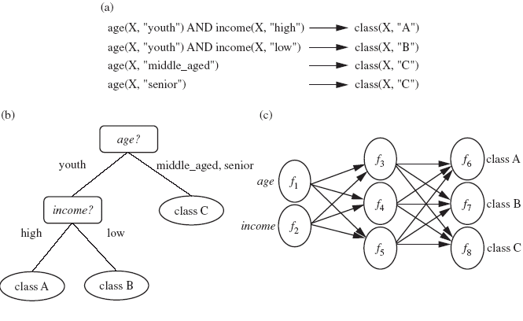

Slide 26
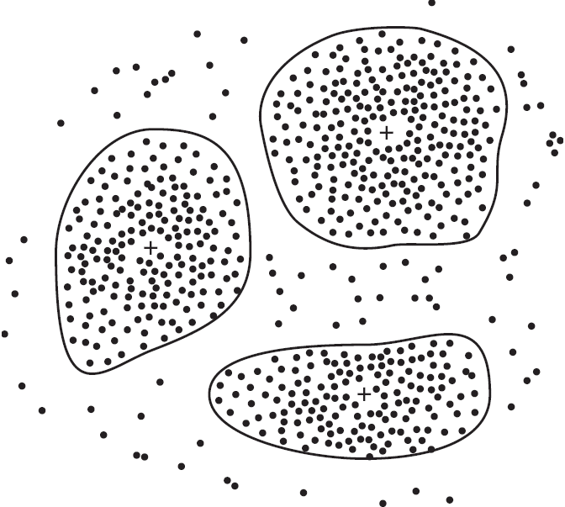
Data Mining Functionalities (2)
Cluster Analysis
Class label is unknown: group data to form new classes
Clusters of objects are formed based on the principle of maximizing intra-class similarity & minimizing interclass similarity
E.g. Identify homogeneous subpopulations of customers. These clusters may
represent individual target groups for marketing.

Slide 27
Data Mining Functionalities (2)
Outlier Analysis
Data that do no comply with the general behavior or model.
Outliers are usually discarded as noise or exceptions.
Useful for fraud detection.
E.g. Detect purchases of extremely large amounts
Evolution Analysis
Describes and models regularities or trends for objects whose
behavior changes over time.
E.g. Identify stock evolution regularities for overall stocks and for the stocks of
particular companies.

Slide 28
Major Issues in Data Mining
Mining methodology and User interaction
Mining different kinds of knowledge
DM should cover a wide spectrum of data analysis and knowledge discovery tasks
Enable to use the database in different ways
Require the development of numerous data mining techniques
Interactive mining of knowledge at multiple levels of abstraction
Difficult to know exactly what will be discovered
Allow users to focus the search, refine data mining requests
Incorporation of background knowledge
Guide the discovery process
Allow discovered patterns to be expressed in concise terms and different levels of abstraction
Data mining query languages and ad hoc data mining
High-level query languages need to be developed
Should be integrated with a DB/DW query language

Slide 29
Major Issues in Data Mining
Presentation and visualization of results
Knowledge should be easily understood and directly usable
High level languages, visual representations or other expressive forms
Require the DM system to adopt the above techniques
Handling noisy or incomplete data
Require data cleaning methods and data analysis methods that can handle noise
Pattern evaluation – the interestingness problem
How to develop techniques to access the interestingness of discovered patterns, especially with subjective measures bases on user beliefs or expectations

Slide 30
Major Issues in Data Mining
Performance Issues
Efficiency and scalability
Huge amount of data
Running time must be predictable and acceptable
Parallel, distributed and incremental mining algorithms
Divide the data into partitions and processed in parallel
Incorporate database updates without having to mine the entire data again from
scratch
Diversity of Database Types
Other database that contain complex data objects, multimedia data,
spatial data, etc.
Expect to have different DM systems for different kinds of data
Heterogeneous databases and global information systems
Web mining becomes a very challenging and fast-evolving field in data mining

Slide 31
Most Common Applications Of Data Mining 2023
Examples Of Data Mining In Real Life
#1) Mobile Service Providers
#2) Retail Sector
#3) Artificial Intelligence
#4) Ecommerce
#5) Science And Engineering
#6) Crime Prevention
#7) Research
#8) Farming
#9) Automation
#10) Dynamic Pricing
#11) Transportation
#12) Insurance

Slide 32
Data Mining Examples In Finance
#1) Loan Payment Prediction
#2) Targeted Marketing
#3) Detect Financial Crimes
Applications Of Data Mining In Marketing
#1) Forecasting Market
#2) Anomaly Detection
#3) System Security
Examples Of Data Mining Applications In Healthcare
#1) Healthcare Management
#2) Effective Treatments
#3) Fraudulent And Abusive Data
Data Mining And Recommender Systems
Data Mining For CRM (Customer Relationship Management)
Data Mining Using Decision Tree Example
Most Popular Example Of Data Mining: Marketing And Sales
Big Companies Using Data Mining

Slide 33
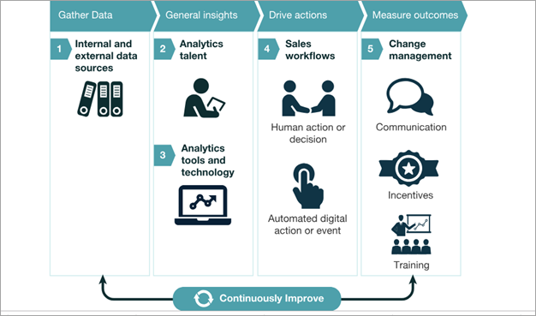
Mobile Service Providers

Slide 34
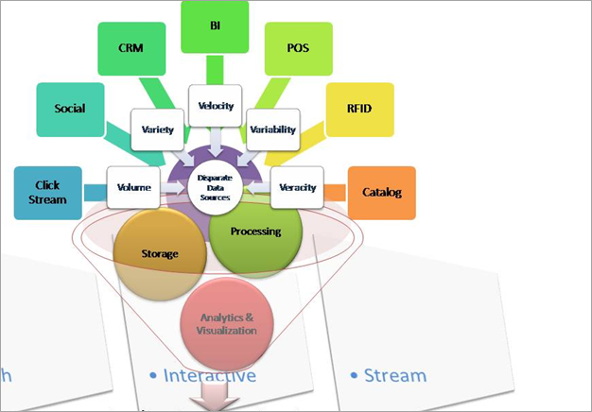
Retail Sector

